Slide 1
RECITATION 7: facility location
15.774/780 (Fall 2021)

Slide 2
Announcements
Simulation assignment due before class 11/1
No lecture/recitation next week (10/25-10/29)
Notes:
Write formulas on the board before class

Slide 3
Agenda
Facility Location
Market potential (ICBC)
Notes:
Write formulas on the board before class

Slide 4
Facility Location
Decision: where do we place service facilities?
Warehouses to ship products from.
Bank branches to service customers.
Bus depots to return to after completing routes.
General tradeoff: cost of opening vs. fulfilling
Notes:
Write formulas on the board before class

Slide 5
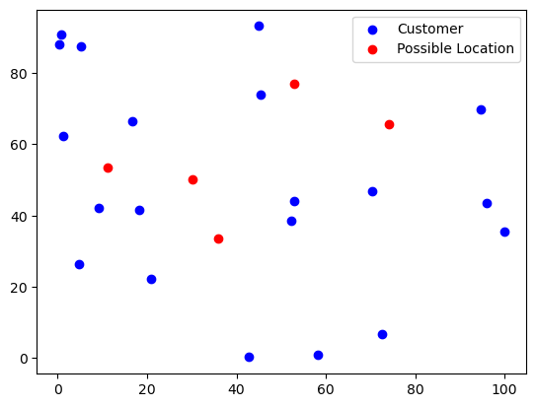

Vanilla Facility Location
$J$possible locations, $I$ customers
$C_{j}$ : cost of opening at location $J$
$c_{ij}$: cost of servicing customer $i$ from location $j$ (if open)
$N$: maximum number of locations to open
Notes:
Write formulas on the board before class

Slide 6
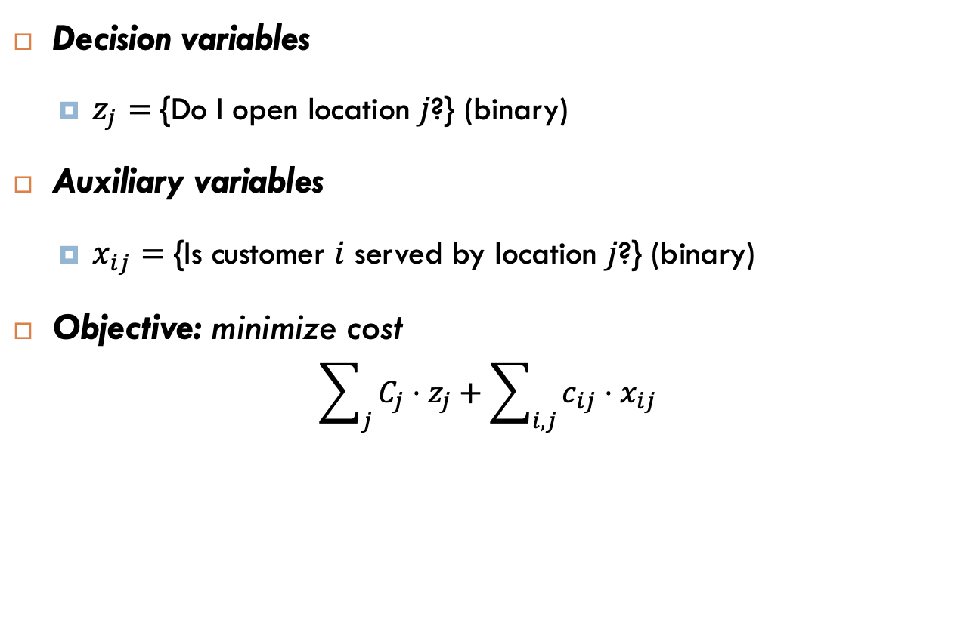
Vanilla Facility Location
Decision variables
$z_{j}=${Do I open location $j$?} (binary)
Auxiliary variables
$x_{ij}=${Is customer $i$ served by location $j$?} (binary)
Objective: minimize cost
$$\sum_{j}{C_{j}⋅z_{j}}+\sum_{i,j}{c_{ij}⋅x_{ij}}$$
Notes:
Write formulas on the board before class

Slide 7
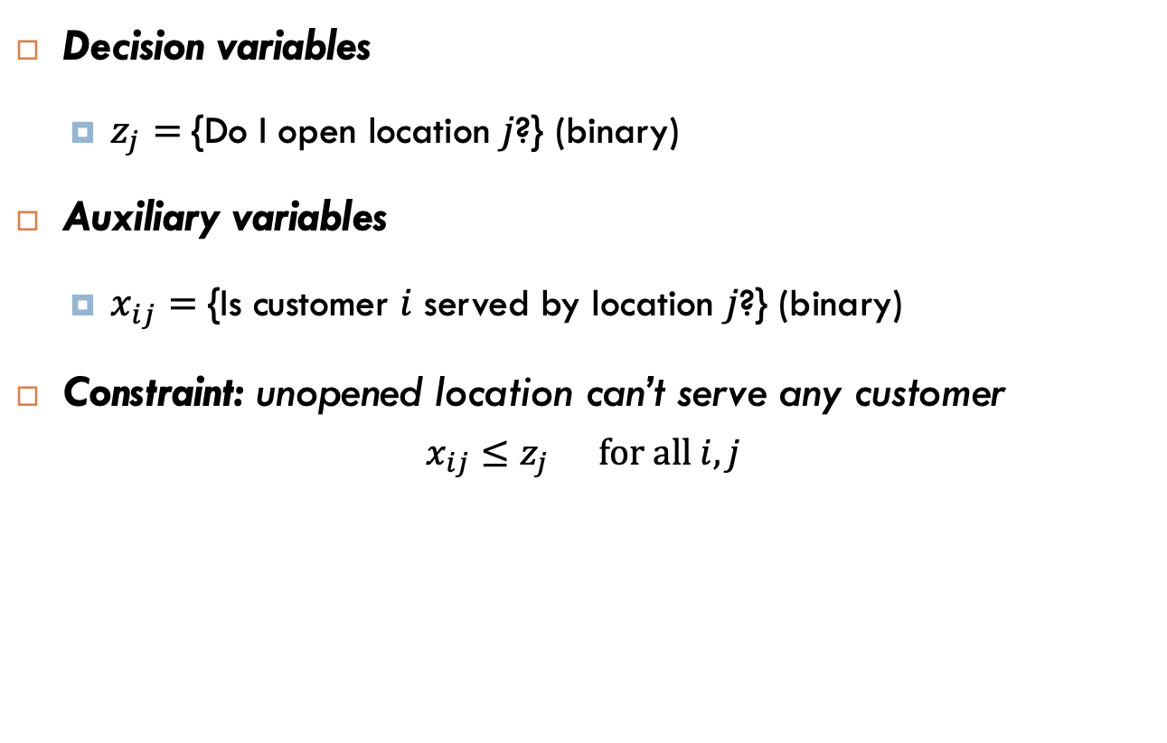
Vanilla Facility Location
Decision variables
$z_{j}=${Do I open location $j$?} (binary)
Auxiliary variables
$x_{ij}=${Is customer $i$ served by location $j$?} (binary)
Constraint: unopened location can’t serve any customer
$$x_{ij}≤z_{j} for all i,j$$
Notes:
Write formulas on the board before class

Slide 8
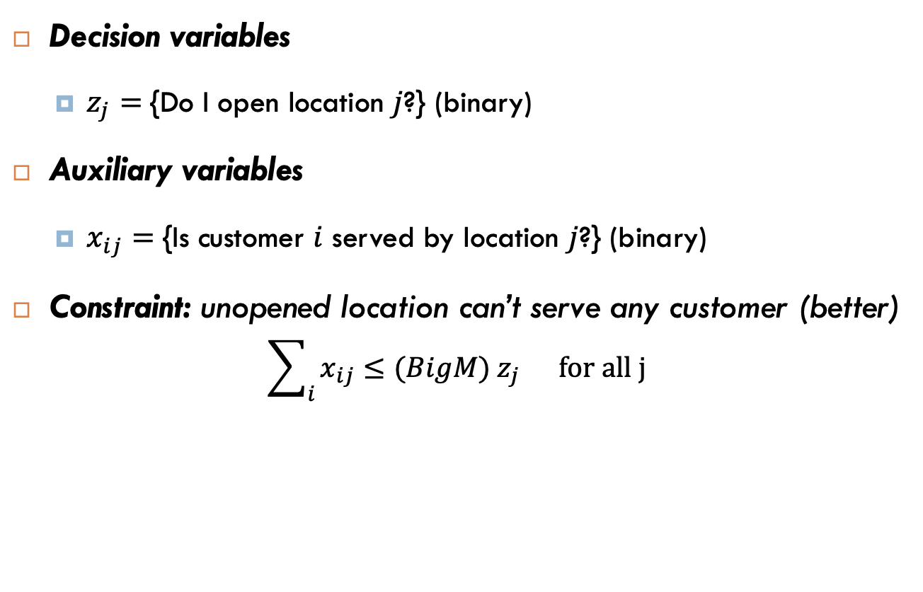
Vanilla Facility Location
Decision variables
$z_{j}=${Do I open location $j$?} (binary)
Auxiliary variables
$x_{ij}=${Is customer $i$ served by location $j$?} (binary)
Constraint: unopened location can’t serve any customer (better)
$$\sum_{i}{x_{ij}}≤(BigM) z_{j} for all j$$
Notes:
Write formulas on the board before class

Slide 9
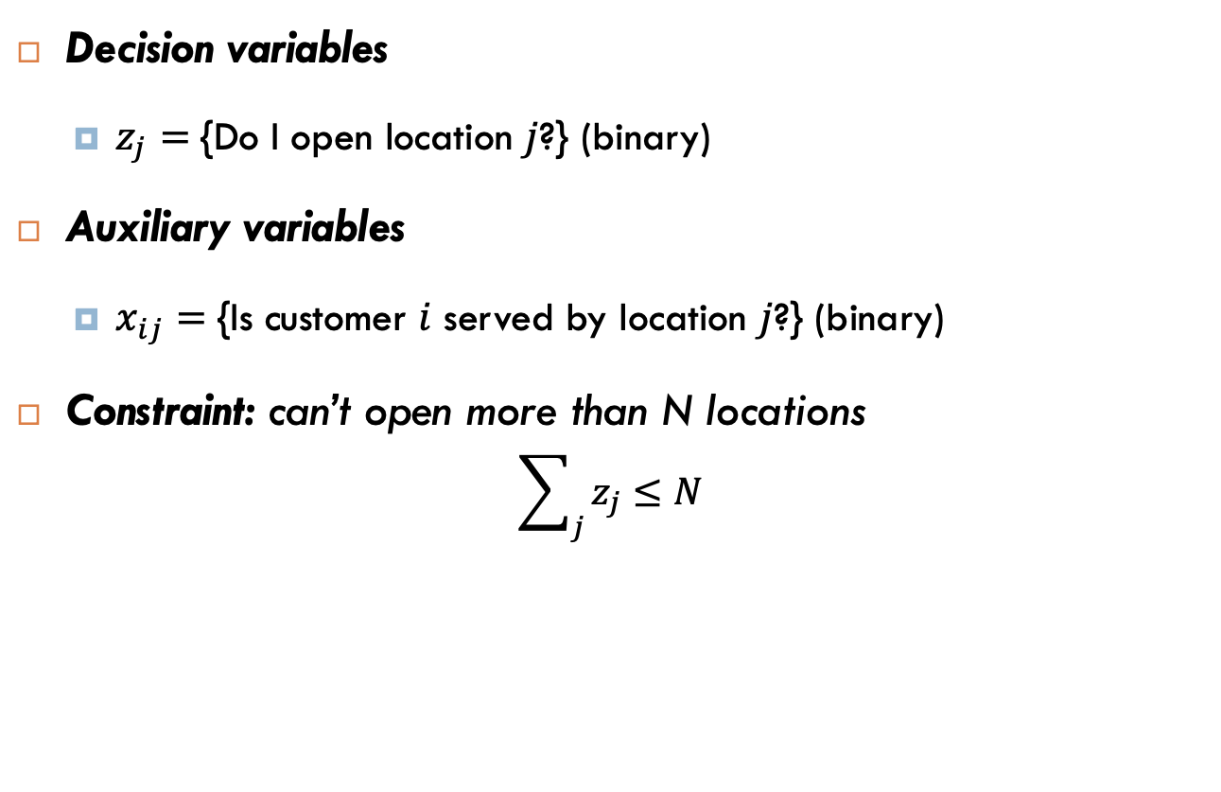
Vanilla Facility Location
Decision variables
$z_{j}=${Do I open location $j$?} (binary)
Auxiliary variables
$x_{ij}=${Is customer $i$ served by location $j$?} (binary)
Constraint: can’t open more than N locations
$$\sum_{j}{z_{j}}≤N$$
Notes:
Write formulas on the board before class

Slide 10

Vanilla Facility Location
Decision variables
$z_{j}=${Do I open location $j$?} (binary)
Auxiliary variables
$x_{ij}=${Is customer $i$ served by location $j$?} (binary)
Constraint: every customer must be served by a location
$$\sum_{j}{x_{ij}}=1 for all i$$
Notes:
Write formulas on the board before class

Slide 11
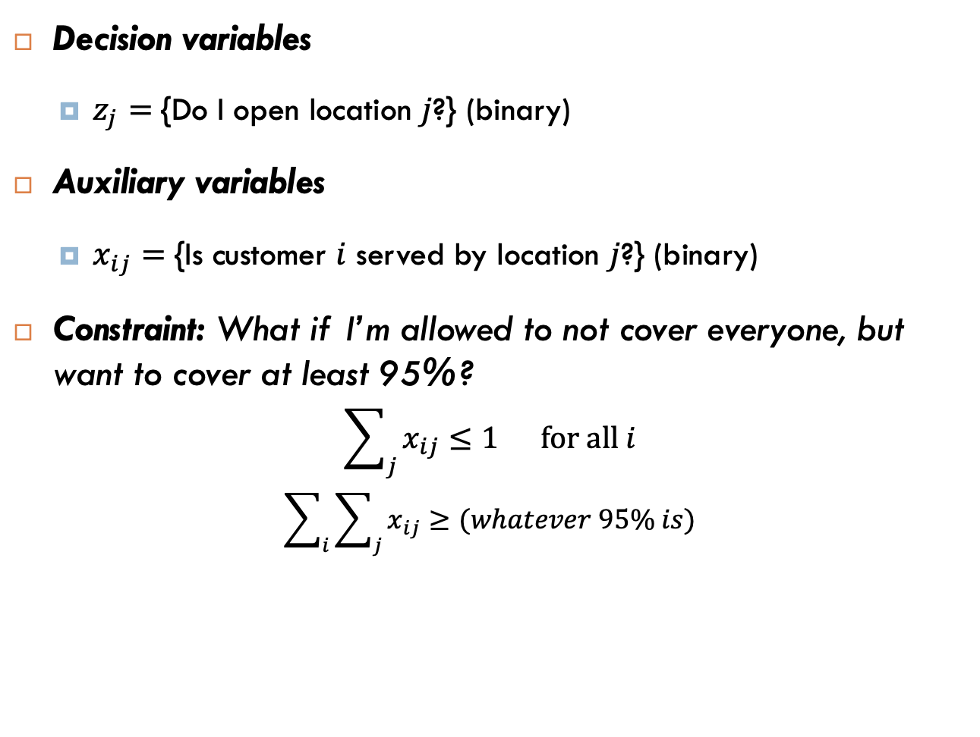
Exercise
Decision variables
$z_{j}=${Do I open location $j$?} (binary)
Auxiliary variables
$x_{ij}=${Is customer $i$ served by location $j$?} (binary)
Constraint: What if I’m allowed to not cover everyone, but want to cover at least 95%?
$$\sum_{j}{x_{ij}}≤1 for all i$$
$$\sum_{i}{\sum_{j}{x_{ij}}}≥(whatever 95\% is)$$
Notes:
Write formulas on the board before class

Slide 12
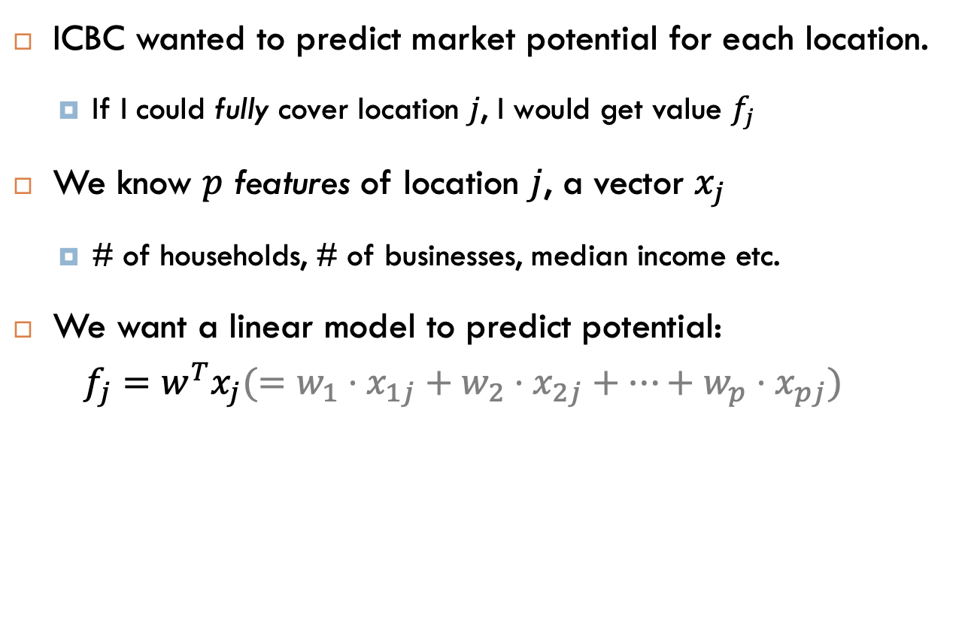
ICBC Market Potential
ICBC wanted to predict market potential for each location.
If I could fully cover location $j$, I would get value $f_{j}$
We know $p$ features of location $j$, a vector $x_{j}$
# of households, # of businesses, median income etc.
We want a linear model to predict potential:
$$f_{j}=w^{T}x_{j}(=w_{1}⋅x_{1j}+w_{2}⋅x_{2j}+…+w_{p}⋅x_{pj})$$
Challenge: we can’t run linear regression because we don’t have (x, y) pairs for “similar” locations!
Notes:
Write formulas on the board before class

Slide 13
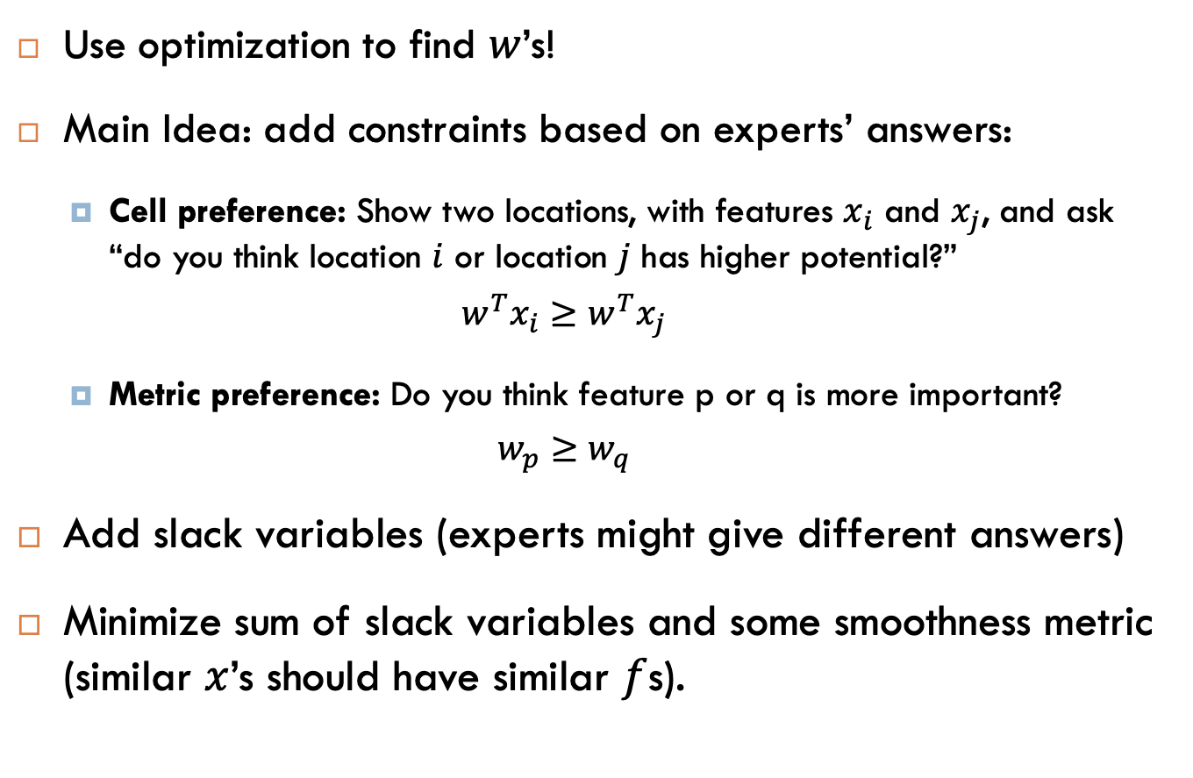
Using expert advice
Use optimization to find $w$’s!
Main Idea: add constraints based on experts’ answers:
Cell preference: Show two locations, with features $x_{i}$ and $x_{j}$, and ask “do you think location $i$ or location $j$ has higher potential?”
$$w^{T}x_{i}≥w^{T}x_{j}$$
Metric preference: Do you think feature p or q is more important?
$$w_{p}≥w_{q}$$
Add slack variables (experts might give different answers)
Minimize sum of slack variables and some smoothness metric (similar $x$’s should have similar $f$s).
Notes:
Write formulas on the board before class

